Slide 1
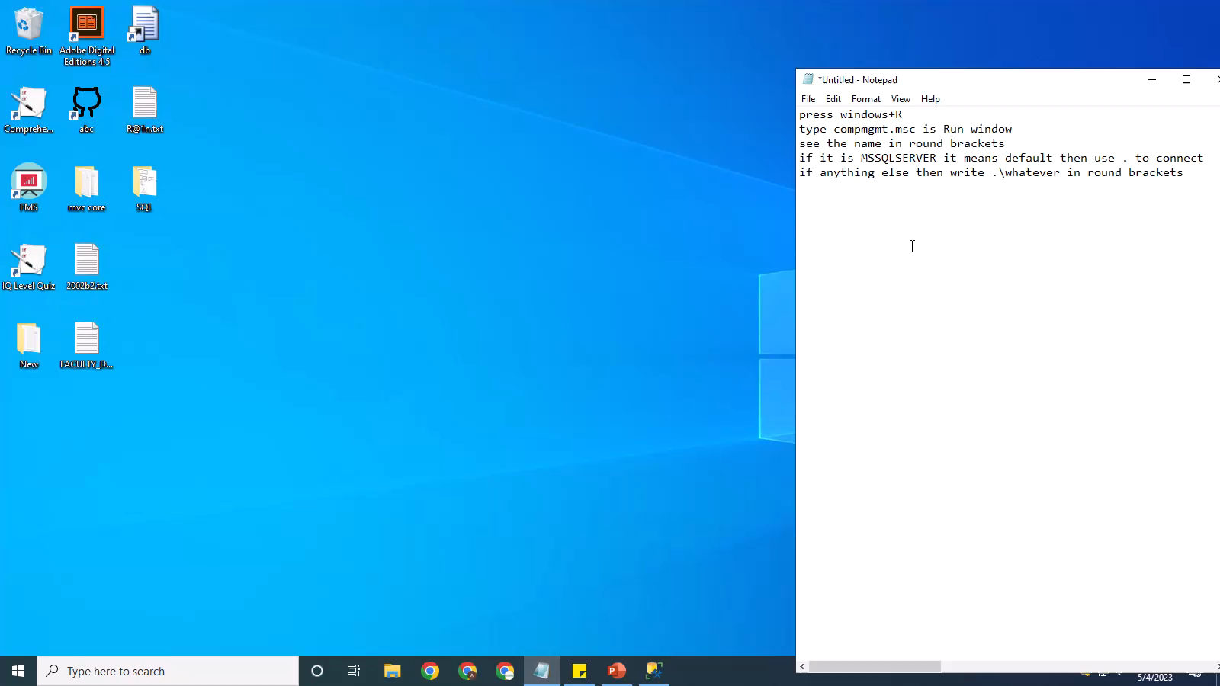

Slide 2
press windows+R
type compmgmt.msc is Run window
see the name in round brackets
if it is MSSQLSERVER it means default then use . to connect
if anything else then write .\whatever in round brackets
Link:
https://stackoverflow.com/questions/16088151/how-to-find-server-name-of-sql-server-management-studio#:~:text=Open%20up%20SQL%20Server%20Configuration,then%20it's%20the%20default%20instance.

